Slide 1

ONLINE PIZZA ORDERING SYSTEM
K ANSAR
MES24MCA-2026
Department of Computer Applications
MES College of Engineering, Kuttippuram
20/08/2025

Slide 2
PRODUCT OWNER Mrs. PRIYA J D ASSISTANT PROFESSOR DEPARTMENT OF COMPUTER APPLICATIONS MES COLLEGE OF ENGINEERING, KUTTIPPURAM

Slide 3
TABLE OF CONTENTS
Introduction
Objective
Existing System
Proposed System
Motivation
Functionalities
Module Description
Developing Environment
Sprint Backlog
Product Backlog
User Story
Project Plans
Data Flow Diagrams
ER Diagram

Slide 4
ONLINE PIZZA ORDERING SYSTEM
Modern web-based platform for fast, personalized, and convenient pizza ordering.
Developed using MERN Stack (MongoDB, Express.js, React.js, Node.js).
Modules:
User: Browse & customize pizzas, apply offers, track orders, live chat, secure Stripe payment.
Admin: Manage menu, orders, offers, prices, and chats.

Slide 5
ONLINE PIZZA ORDERING SYSTEM
Features:
Pizza customization & special notes.
Real-time tracking & live chat.
Location-based delivery system.
Offers & promotions.
Email order updates.
Invoice generator (PDF).

Slide 6
OBJECTIVES
Deliver a fast, personalized pizza ordering experience.
Allow pizza customization with special notes.
Enable real-time tracking & live chat.
Use location-based delivery for timely service.
Provide secure Stripe payments.
Let admins manage menu, orders & offers.
Generate PDF invoices automatically.

Slide 7
EXISTING SYSTEM
Customers use third-party platforms like Swiggy/Zomato or direct phone/in-person orders.
High commission fees for vendors on third-party platforms.
Limited control over menu, pricing, and offers for vendors.
No dedicated brand identity for individual pizza vendors.
Real-time tracking available but dependent on third-party systems.
Customer support handled by third-party, not directly by vendors.
Invoice generation and detailed order history not fully vendor-controlled.

Slide 8
PROPOSED SYSTEM
Web-based MERN Stack platform for fast, convenient ordering.
Pizza customization with size, crust, toppings & special notes.
Real-time order tracking with location-based delivery.
Live chat between customers and admin for instant support.
Automated PDF invoice generation for each order.
Admin dashboard to manage menu, orders, offers & customer chats.
Email notifications for order updates and promotions.

Slide 9
MOTIVATIONS
Reduce dependency on third-party platforms like Swiggy/Zomato.
Give vendors full control over menu, pricing, offers, and customer data.
Build a dedicated brand identity for pizza vendors.
Provide customers with a direct, personalized ordering experience.
Improve profit margins by avoiding high commission fees.
Enable real-time tracking, chat, and invoice generation within the vendor’s own system.
Enhance customer satisfaction and loyalty through customized offers and instant support.

Slide 10
FUNCTIONALITIES
User Registration & Login – Secure sign-up and authentication for customers.
Menu Browsing – View pizzas with images, prices, and descriptions.
Pizza Customization – Choose size, crust, toppings, and add special notes.
Offers & Promotions – View and apply ongoing discounts during checkout.
Cart & Checkout – Add items to cart and proceed to payment.

Slide 11
FUNCTIONALITIES
Real-Time Order Tracking – Track pizza preparation and delivery status live.
Location-Based Delivery – Ensure accurate and timely deliveries using GPS.
Live Chat Support – Direct communication with admin for quick help.
PDF Invoice Generator – Automatic invoice creation for each order.
Admin Dashboard – Manage menu, orders, offers, chats, and delivery tracking.

Slide 12
MODULE DESCRIPTION
1. User Module
User Registration/Login – Allows customers to create accounts and log in securely.
Pizza Customization – Users can select pizza size, crust, toppings, and add notes.
Offer Viewing – Users can browse and check available discounts, coupons, and promotions.
Order Placement & Tracking – Place orders and track them in real time.
Chat with Admin – Users can ask questions or request changes instantly.
Invoice Download – Users receive a downloadable PDF invoice for each order.

Slide 13
MODULE DESCRIPTION
2. Admin Module
Menu Management – Add, update, or remove pizzas and prices.
Order Management – View, process, and update order status in real time.
Chat System – Respond to customer queries directly.
Offer Management – Create and manage promotional offers.
Invoice & Records – Access and download order invoices.
Delivery Monitoring – Track delivery performance and user satisfaction.
Performance Insights – Monitor sales trends and customer behavior.

Slide 14
DEVELOPING ENVIRONMENT
Operating System: Windows / Linux
Front End: React.js (JavaScript, HTML, CSS)
Back End: Node.js with Express.js
Database: MongoDB (NoSQL)
Real-Time Communication: WebSockets (for chat & order tracking)
PDF Invoice Generation: jsPDF or PDFKit
Location Services: Google Maps API
IDE: Visual Studio Code
Version Control: Git & GitHub

Slide 15
SPRINT PLAN
Backlog tem | Completion Date | Original Estimation in Hours | Day 1 hrs | Day 2 hrs | Day 3 hrs | Day 4 hrs | Day 5 hrs | Day 6 hrs | Day 7 hrs | Day 8 hrs | Day 9 hrs | Day 10 hrs
SPRINT 1
User Auth Setup | 10/08/2025 | 2 | 1 | 1 | 0 | 0 | 0 | 0 | 0 | 0 | 0 | 0
Pizza Customization | 15/08/2025 | 3 | 1 | 1 | 1 | 0 | 0 | 0 | 0 | 0 | 0 | 0
Cart & Checkout Flow | 19/08/2025 | 4 | 1 | 1 | 1 | 0 | 1 | 0 | 0 | 0 | 0 | 0
SPRINT 2
Real Time Oder Tracking | 30/08/2025 | 7 | 1 | 1 | 1 | 1 | 1 | 1 | 1 | 0 | 0 | 0
Live Chat With Admin | 05/09/2025 | 7 | 1 | 1 | 1 | 1 | 1 | 1 | 1 | 0 | 0 | 0

Slide 16
SPRINT PLAN
Backlog tem | Completion Date | Original Estimation in Hours | Day 1 hrs | Day 2 hrs | Day 3 hrs | Day 4 hrs | Day 5 hrs | Day 6 hrs | Day 7 hrs | Day 8 hrs | Day 9 hrs | Day 10 hrs
SPRINT 3
Offer & Promotion System | 13/09/2025 | 8 | 1 | 1 | 1 | 1 | 1 | 1 | 1 | 1 | 0 | 0
Location- Based Delivery | 20/09/2025 | 4 | 1 | 1 | 1 | 1 | 0 | 0 | 0 | 0 | 0 | 0
SPRINT 4
PDF Invoice generation | 30/09/2025 | 7 | 1 | 1 | 1 | 1 | 1 | 1 | 1 | 0 | 0 | 0
Admin Dashboard | 07/10/2025 | 8 | 1 | 1 | 1 | 1 | 1 | 1 | 1 | 1 | 0 | 0
TOTAL |  | 50 | 9 | 9 | 8 | 7 | 5 | 5 | 5 | 2

Slide 17
PRODUCT BACKLOG
ID | NAME | PRIORITY | ESTIMATE (Hours) | STATUS
1 | User Registration/ Login | High | 2 | COMPLETED
2 | Menu & Pizza Customization | High | 3 | IN PROGRESS
3 | Cart & Checkout Flow | High | 4 | IN PROGRESS
4 | Real-Time Order Tracking | High | 7 | IN PROGRESS
5 | Live Chat with Admin | Medium | 7 | IN PROGRESS

Slide 18
PRODUCT BACKLOG
ID | NAME | PRIORITY | ESTIMATE (Hours) | STATUS
6 | Offer & Promotion System | Medium | 8 | IN PROGRESS
7 | Location-Based Delivery | High | 4 | IN PROGRESS
8 | PDF Invoice Generation | Medium | 7 | IN PROGRESS
9 | Admin Dashboard | High | 8 | IN PROGRESS

Slide 19
USER STORY
User Story ID | As a type of User | I want to | So that i can
1 | USER | Register | Create an account and start ordering pizzas
2 |  | Login | Access my account securely with correct credentials
3 |  | Browse & Customize Menu | View pizzas, sizes, crusts, toppings, and add special notes
4 |  | Apply Offers | Get discounts on my order
5 |  | Place & Track Orders | Confirm my order, proceed to payment, and monitor delivery status.

Slide 20
USER STORY
User Story ID | As a type of User | I want to | So that i can
6 | ADMIN | Manage Menu | Add, update, or remove pizzas and prices
7 |  | Manage Orders | View, update, and process customer orders
8 |  | Manage Offers | Create promotions to attract customers
9 |  | Chat with Customers & Monitor Delivery | Provide quick support and ensure timely, accurate delivery

Slide 21
PROJECT PLAN
User StoryID | Task Name | Start Date | End Date | Days | Status
1 | Sprint 1 | 06/08/2025 | 10/08/2025 | 14 | Completed
2 |  | 11/08/2025 | 15/08/2025 |  | In Progress
3 |  | 16/08/2025 | 19/08/2025 |  | In Progress
4 | Sprint 2 | 23/08/2025 | 30/08/2025 | 14 | In Progress
5 |  | 31/08/2025 | 05/09/2025 |  | In Progress

Slide 22
PROJECT PLAN
User StoryID | Task Name | Start Date | End Date | Days | Status
6 | SPRINT 3 | 07/09/2025 | 13/09/2025 | 14 | In Progress
7 |  | 14/09/2025 | 20/09/2025 |  | In Progress
8 | SPRINT 4 | 24/09/2025 | 30/09/2025 | 14 | In Progress
9 |  | 01/10/2025 | 07/10/2025 |  | In Progress

Slide 23
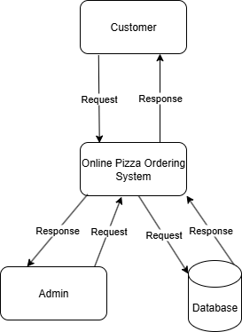
DATA FLOW DIAGRAM
Level 0

Slide 24
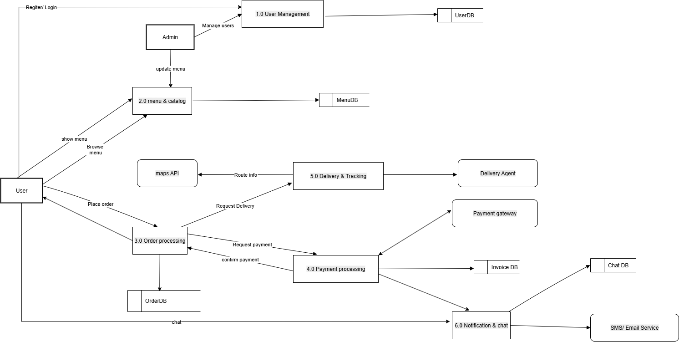
DATA FLOW DIAGRAM
Level 1

Slide 25
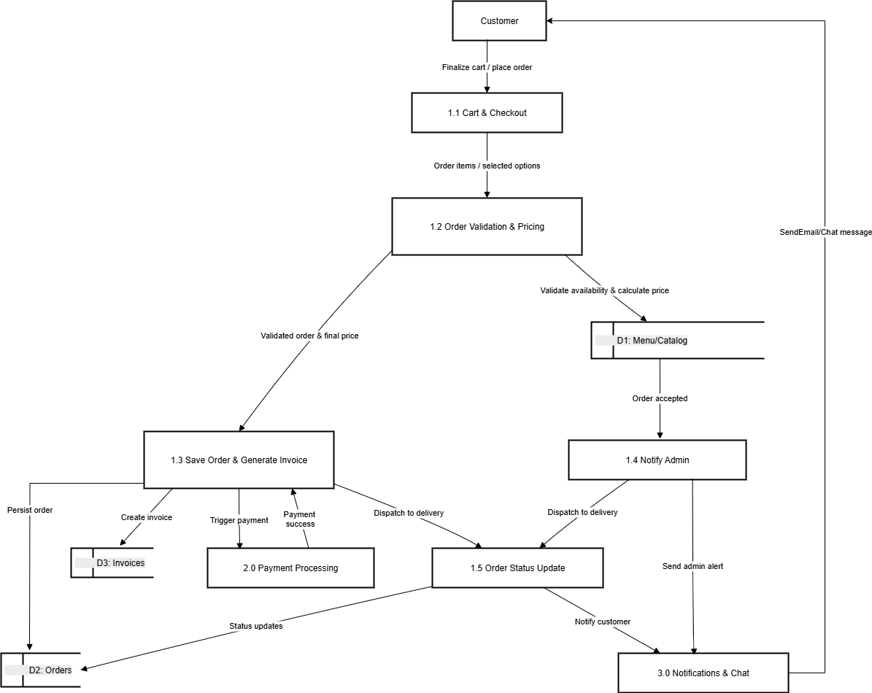
DATA FLOW DIAGRAM
Level 2

Slide 26
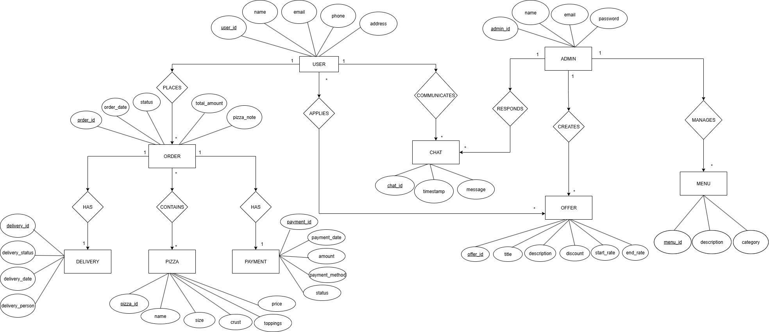
ER DIAGRAM

Slide 27
THANK YOU

